Slide 1


comprehensive understanding of Git and GitHub
Git?
Github?
ReadMe file?
Configuring git?
Git commands?
Workflow?
Git branch
Merging code
Pull command
Undoing Changes

Slide 2


what is git?
before study Git we need to understand version control system.
Version control system is a tool that helps to track changes in code.
Git is a version control system and it is :
Popular
Free and Open source
Fast and Scalable

Slide 3





We primarily use Git for two main purposes:
Track the history
Collaboration
2. Github
it is website that allow developers to stor and manage there code using Git.
GitHub is a website where you can store your Git projects online, collaborate with others, and showcase your work.
It's great for teamwork, open-source projects, and portfolio building.

Slide 4
3. ReadMe file
A README is a text file (usually README.md) that explains your project.
In the README, we write to explain
what the project is,
what its name is,
how to use it,
why you created this project,
what features it includes,
and other related information.
If you know basic HTML, you can make your README.md file look better and more organized.

Slide 5
4. Configuring Git
Configuring Git means setting up your Git environment so it knows who you are and how to behave.
Configuration Levels:
System level: Settings for everyone using Git on the same computer.
Example: Default editor for all users.
Global level: Settings for you, the current user.
Example: Your name and email for all your projects.
Local level: Settings for one specific project.
Example: Using a different username or email just for that repo.

Slide 6

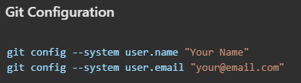
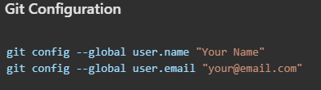
System level (for all users on the computer):
🔐 Needs admin
/root access.
Global level (for your user account):
Most commonly
used.

Slide 7
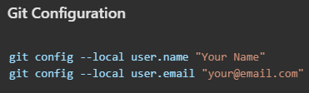


Local level (for current project/repo):
💡 Run this inside
the project folder.
You can view the config using:

Slide 8


5. Git commands
git clone <url>
Cloning a repositery on your local machine.
git status
Display the status of your code
Untracked
The new file that not tracked yet.
Modified
Changed
Unmodified
being tracked by Git and has no changes
Staged
files are ready to be committed
git add <file name>
add changes or new file in working directory
git add .
add all changes at once

Slide 9
git commit -m "message"
It’s record of changes.
git push origin main
Upload local repo content to remote repo
git init
Used to create new repo
git remote add origine < link >
git remote -v
To verify remote
git branch
To check branch
git branch -m main
To rename branch
git push origin main
we use -u for upstream , it use to work long time to overcome write of origin main.
git push -u origin main

Slide 10
GitHub Repo
↓
Clone Repository
(git clone <url>)
↓
Make Changes
(edit files)
↓
Stage Changes
(git add .)
↓
Commit Changes
(git commit -m "message")
↓
Push to GitHub
(git push)
6. Workflow

Slide 11



Fetures
Git Branch
Master
git branch → to check branch
git branch -m main → to rename branch
git checkout <branch name> → to navigate (to go 2nd branch)
git chckout -b <branch name> → to create new branch
git branch -d <branch name> → to delet branch

Slide 12
Merging code
Two way to merge your code
Way 1
git diff <branch name> → to compare commits branches, files and more
git merge <branch name> → to merge two branchs
Way 2
create a pull request (PR)
It let you tell others about changes you’ve pushed to a branch in a repository on github.

Slide 13
Pull command
git pull is used to download the latest changes from the remote repository (like GitHub) and merge them into your local project.
git pull origin main → Pull (download and merge) the latest code from the main branch of the remote repo named origin.
Resolving Merge Conflict
An event that takes place when git is unable to autometically resolve .
git log → to check all commits

Slide 14
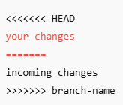
Manually fix conflict
Edit the file, remove the <<<<<<<, =======, and >>>>>>>
After remove all this type of lines you can run the command
git add <file>
git commit -m "Resolved merge conflict"
git push

Slide 15
Undoing Changes
some changes add by mistake
Case 1 - Staged change → files are add but not commited
git reset <filename> → for one file
git reset → for all file
Case 2 - commited changes → for one commit
git reset HEAD~1 → Removes the last commit
Keeps the changes in unstaged state (you won’t lose your work)
Case 3 - commited changes → for many commits
git reset <commit-hash> → multiple commit se wapas jane ke liye hash use karte hai
git reset -hard → delete all change or change remove ho jate hai

Slide 16

I HOPE YOU LEARN SOMETHING FROM HERE

